Slide 1
Elevator Control System
Inturi Sai Harshini
Haiwen Shi
Feiou Zhang

Slide 2
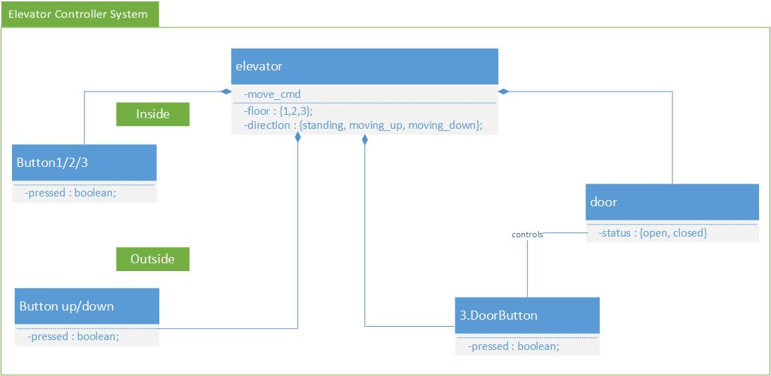
Architecture

Slide 3
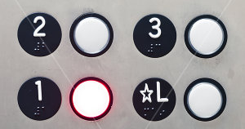


Variables of the elevator system
floor button
Button1| button2 | button3 : boolean;
up and down button
upF1 | upF2 | downF2 | downF3: boolean;
door button
buttonOpen | buttonClose: boolean;

Slide 4
Variables of the elevator system
floor : {1,2,3};
direction : {standing, moving_up, moving_down};
door : {open, closed};
move_cmd : {stop, move_up, move_down, nop};

Slide 5
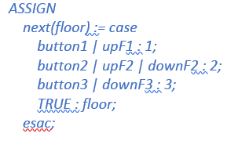
Assignment of the elevator system
floor : {1,2,3};

Slide 6
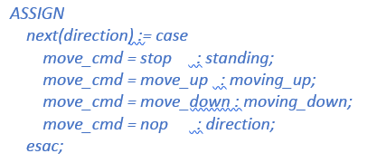
Assignment of the elevator system
direction : {standing, moving_up, moving_down};

Slide 7
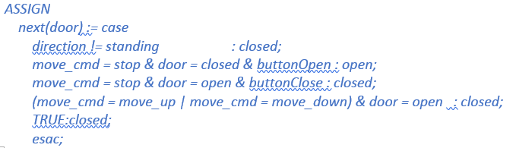
Assignment of the elevator system
door : {open, closed};

Slide 8
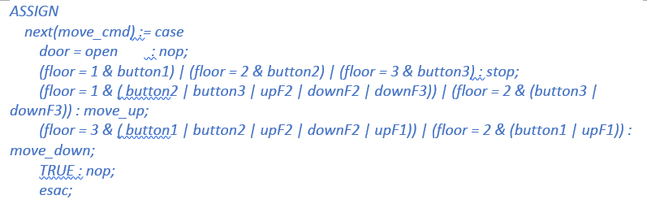
Assignment of the elevator system
move_cmd : {stop, move_up, move_down, nop};

